Slide 1


Blockchain-based eCommerce warranty system using NFTs
Team Name: Outliers
Institute Name: Indian Institute of Technology, Jodhpur (IIT Jodhpur)

Slide 2

Team members details
Team Name | Outliers
Institute Name | Indian Institute of Technology, Jodhpur (IIT Jodhpur)
Team Members > | 1 (Leader) | 2 | 3
Name | Krishna Thoriya | Ved Thakur | -
Batch | 2023 | 2023 | -

Slide 3
Deliverables/Expectations for Level 2 (Idea + Code Submission)
The solution should focus on:
The blockchain smart contract should allow users to prove ownership
Provide the purchasing history, warranty period, and other item information
The warranty card should include the item’s serial number and upon purchase be sent to the customer’s smartphone.
The NFTs should be decaying in nature, in that, after a certain period their use for the redemption of warranty benefits offered by the brand/retailer will expire
Bonus - GUI-based tool that doesn’t require knowledge of any Blockchain programming to use by Brands and Retailers.
Bonus - Usage of Soulbound NFTs
Bonus - Add any engagement/gamification construct to the loyalty program

Slide 4
Glossary
Abbreviations used
NFTs : Non-Fungible Tokens
IRA : Information Retrieval Algorithm
DWCs : Digital Warranty Cards
URL : Uniform Resource Locator

Slide 5
Use-cases
P0 – Customer wants to request DWC of the item purchased
P0 – Customer wants to transfer ownership of DWC after resale
P1 – Automatic NFT Burning

Slide 6
Solution statement/ Proposed approach
When a customer buys any product from the seller (an eCommerce website - Flipkart), the corresponding brand having Flipkart account gets a notification from seller regarding successful purchase by customer XYZ.
The process begins at the brand employer side regarding generating DWCs for the customers.
The generation process uses IRA where it utilizes product details and purchasing history.
The IRA extracts all the information from the customer details that an employer received and creates an .jpeg/png image, which can be used to create DWC later.
After this, the brand can mint and transfer the DWC as an NFT to the particular customer’s eCommerce/Metamask wallet.
Once the customer receives a DWC for his/her product/(s), it can be transferred to other customers without any brand intervention.
After the warranty period, the DWCs can be burnt from the customer’s as well as brand’s end.

Slide 7
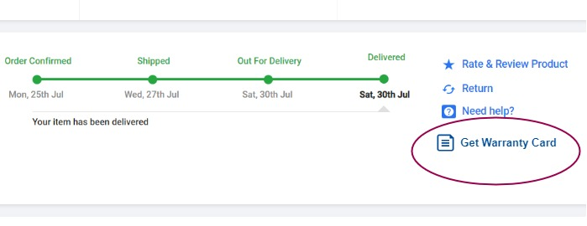
On Flipkart(seller)’s side: (Getting requests for warranty cards)
This approach implements a new feature which allows buyers/users to download
a digital warranty card for his/her product/(s).
After purchasing the item, order details section will look as same as shown below.

Slide 8
On the brand’s side:
(DWCs generation, minting and transferring)
On clicking ‘Get Warranty Card’, the buyer will be able to get the digital warranty card.
The Logistics and operations department for the particular brand will get an Flipkart notification, where the brand can see the request to get a DWC from the buyer’s side along with all the details of an buyer and purchased product.
Once the employer who is operating has an all the product details, can now use the IRA to get DWCs generated.
Since we don’t have an access as a seller or brand, we have shown the generation of an image having the customer details by entering the data of the customer XYZ for example.

Slide 9
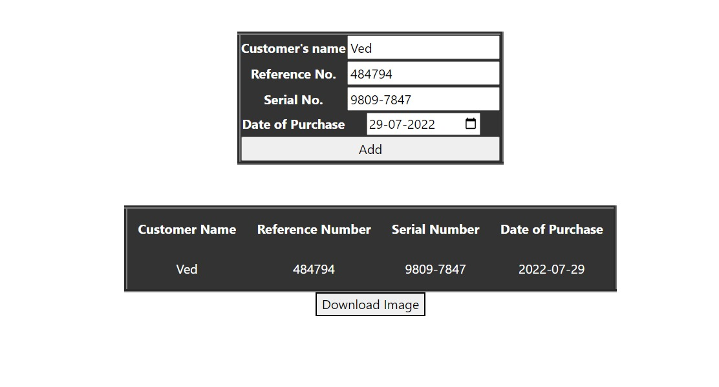
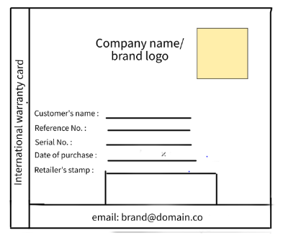
Data extraction
Image generation
The ‘download image’ will be redirected to a ‘Minting Website’ where the employee will mint a DWC. This is as simple as it looks in the image below for the employee who doesn’t have prior knowledge of blockchain and NFTs.
After entering the correct details for the all of the fields shown in the below image, the employer will be able to mint the image as an Digital NFT Warranty Cards

Slide 10
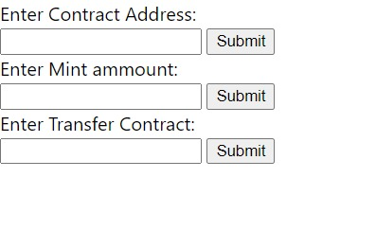
Minting an image
After entering the correct details for the all of the fields shown in the below image, the employer will be able to mint the image as an Digital NFT Warranty Cards
All the details will be available at the brand employer’s side who is handling minting part and this is further explained in the code explanation video.
NOTE: The deployment, solidity and smart contract related implementation have been explained in the coe explanation video

Slide 11
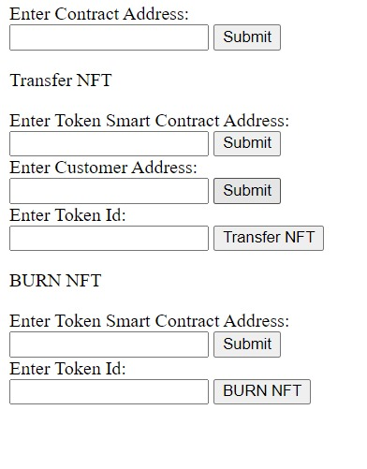
On the customer’s and brand’s side: (Transferring and burning DWCs)
Once we have a minted DWC, the ownership can now be transferred to the customer or it can be transferred to the another customer by entering the details upon resale.
The DWCs can be burnt by the owner as well as the brand admin.
Here, by this implementation, the access of the buyer can be removed and the DWCs can be transferred to the garbage account/address.
Transferring and burning ownership

Slide 12
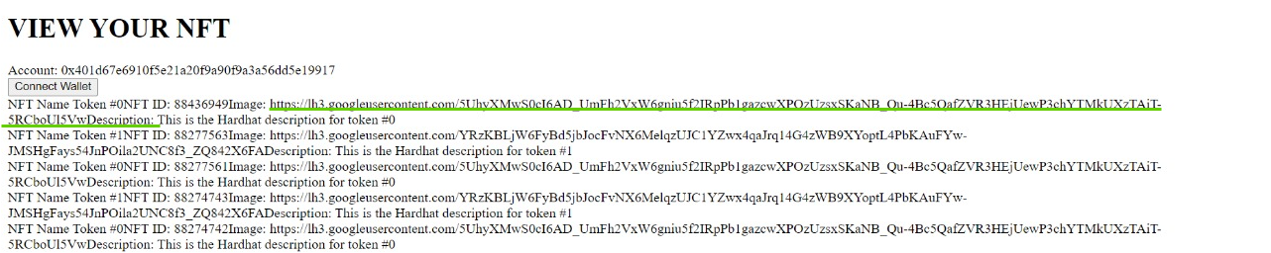
On the customer’s side:
After transferring the DWCs to the corresponding user’s/buyer’s account, one can see the image (Here, we have shown the warranty card URL, on clicking it the buyer is redirected to the page from where the DWC can be viewed)

Slide 13
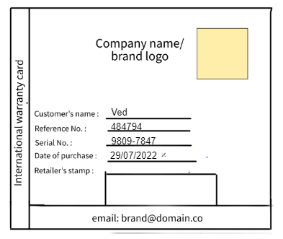
At last, the buyer can have the downloaded DWC just after the purchase.
This warranty card can be linked with the digital wallet or metamask account which is pre-integrated with the eCommerce account.

Slide 14
Limitations
Since NFTs can not be burnt by themselves, A buyer has to burn digital warranty card.
Once the NFT is minted, no further changes can be made to its content, the details after
Repair or exchanged or replacement can not be updated but the DWC can be destroyed.

Slide 15
Future Scope
Automatic deletion of DWC
The content of the DWCs can be updated or changed upon resale or on replacement.

Slide 16
Thank you
- Krishna Thoriya
- Ved Thakur
(Indian Institute of Technology, Jodhpur)

